Slide 1
FFTcamera material
Manuel Guizar-Sicairos :: Head of the Computational X-ray Imaging group :: Paul Scherrer Institute
Associate Professor :: École Polytechnique Fédérale de Lausanne
PHYS-715 Physical Optics and Advanced Imaging

Slide 2
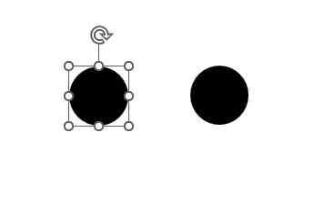


General instructions
The FFTcamera app will show you the live Fourier transform of the image in your camera.
Follow the instructions in the notes for the slides, try to prove different Fourier theorems by changing the structures that appear in the slides
Tip: Sometimes the autofocus does not work, if you have a blurry image then close the app and open again
See below. If you select one of the structures, the dots, the square around, and the rotation indicator will affect your FFT, so make sure to de-select the feature to see the unaltered effect

Slide 3
Notes:
Demonstrate the similarity (scaling) theorem
Solution
The FT scaling theorem says that if an object is larger the FT gets smaller, and viceversa. You can prove this by making the square larger or smaller, or by putting the camera closer or farther from the screen
Make it a rectangle to see how this is manifested in the FT

Slide 4
Notes:
What happens if you have two structures that are the same?
Can you explain what you see?
What happens if you make the dots closer, or farther apart?
What is the connection to diffraction by two pinholes?
What happens if you rotate the image?
Can you prove the shifting theorem
Solution: Moving the objects within the camera results in no change of the FT

Slide 5
Notes:
What happens when the “pinholes” become delta functions?
Can you explain why?

Slide 7
Notes:
What happens if you have an object that is infinitely repeated?
This is analogous to diffraction from a crystal
Why do you see peaks?

Slide 8
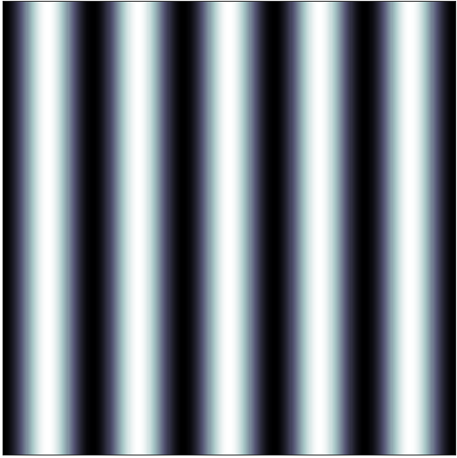


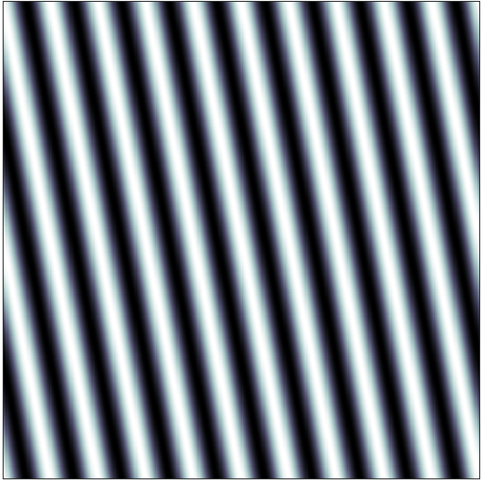
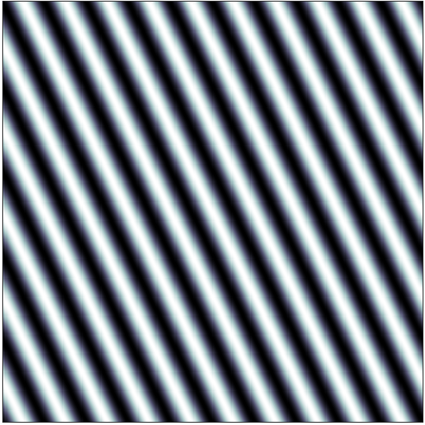
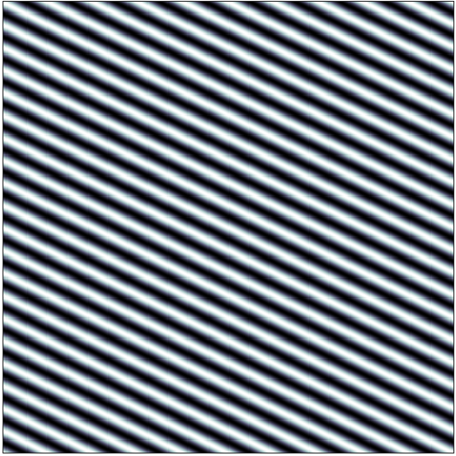
Notes:
These are sine waves. Put each of the squares above in the camera.
These should have a single spatial frequency. Therefore only 3 peaks should appear.
However, you can see that many peaks appear in the image. Why?

Slide 9


Notes:
See the FT of of the logos
Zoom into the PSI logo, what is the FFT of all the dots?
If you zoom a lot on the dots you will see a central blob and a ring. Why?

Slide 10
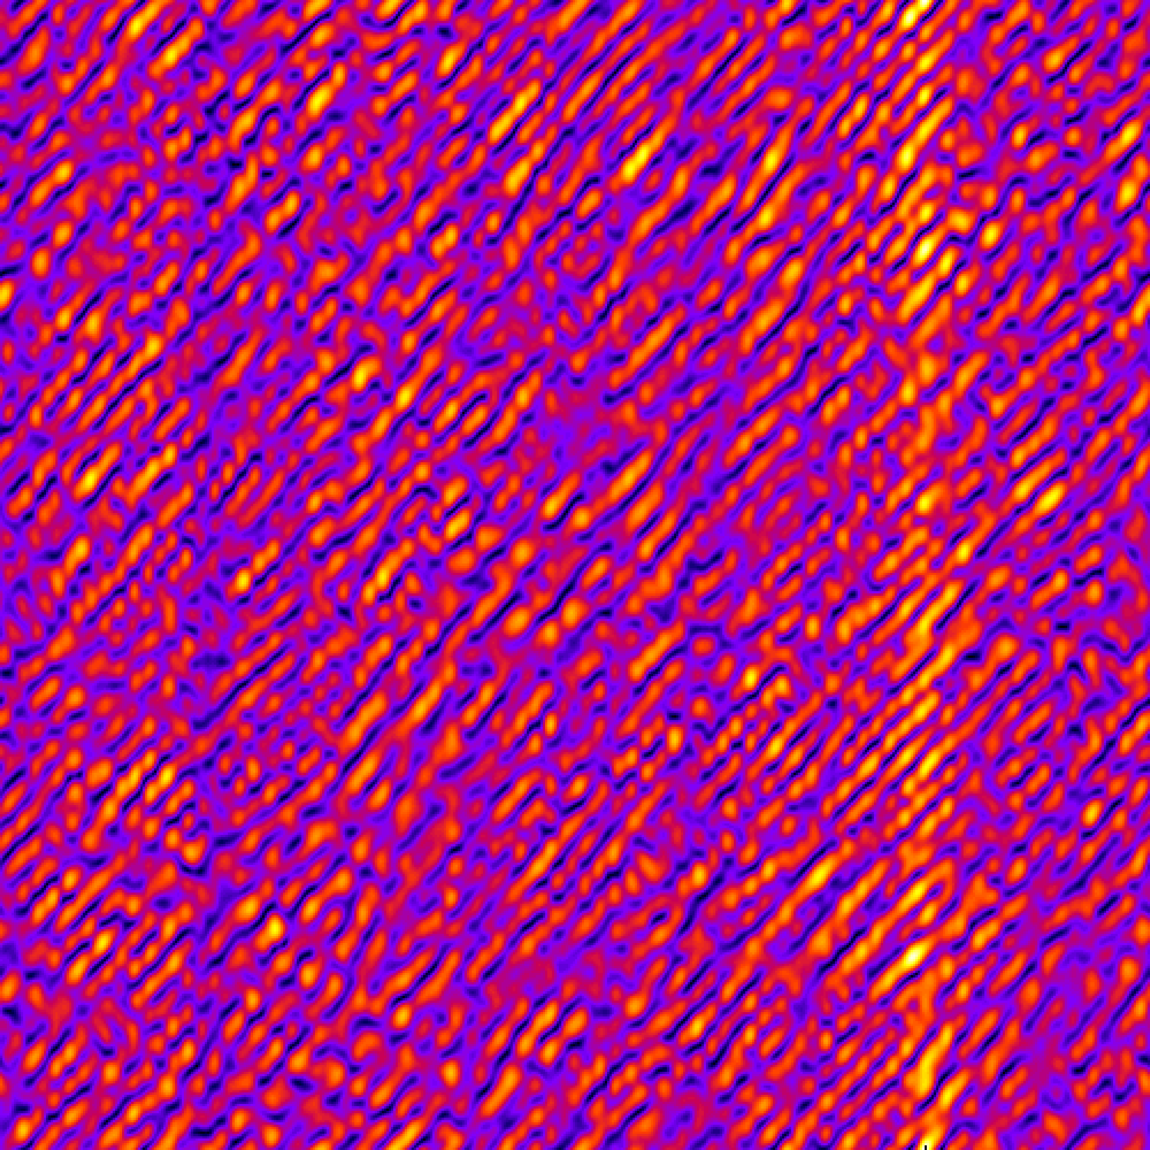
Notes:
This is a computer-generated digital hologram. The diffraction would generate a designed pattern if you illuminated with a laser. You can do that with the FFTcamera
Can you see the image hidden in the FT?

Slide 11
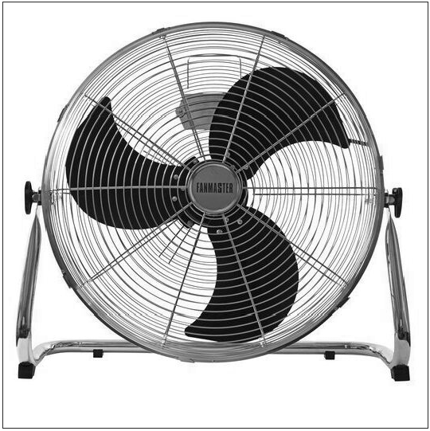

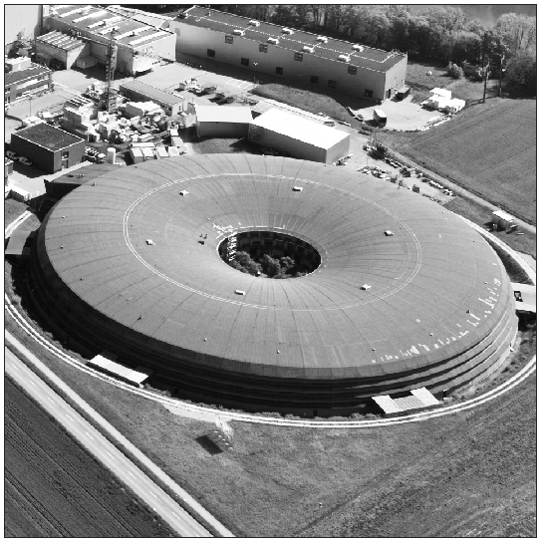
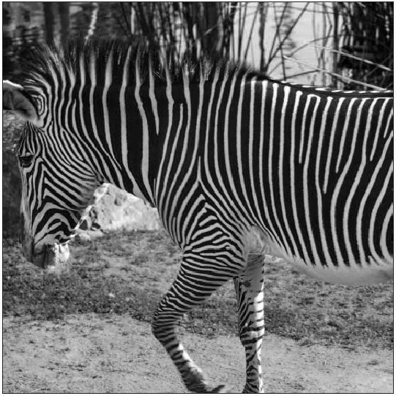
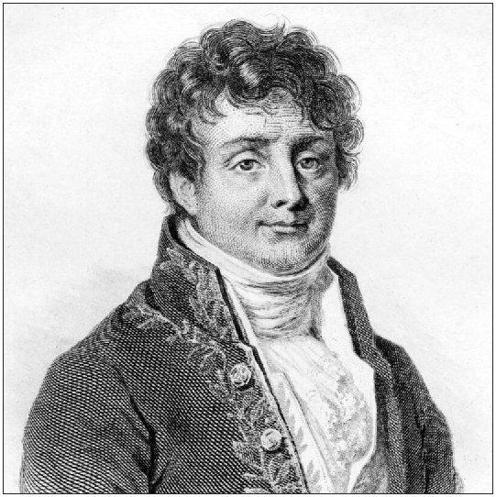

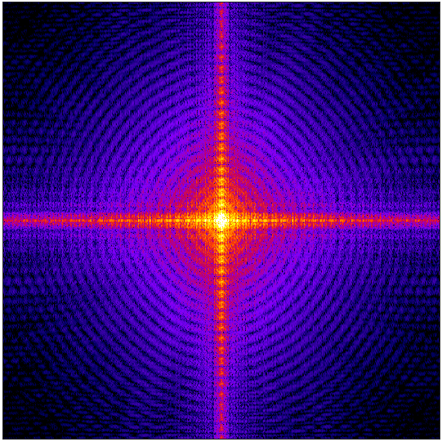
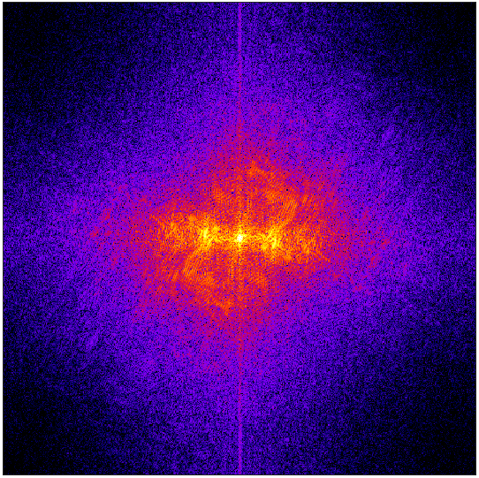
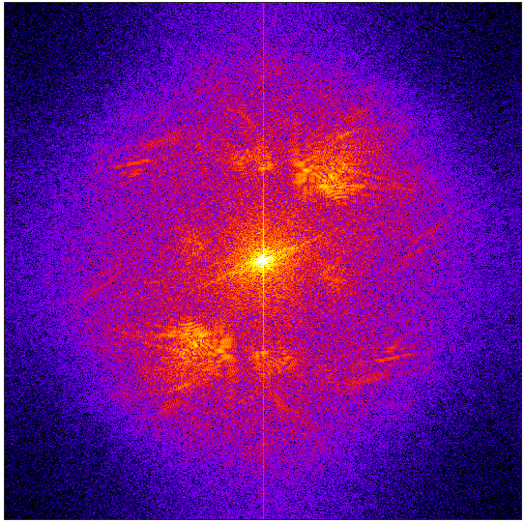
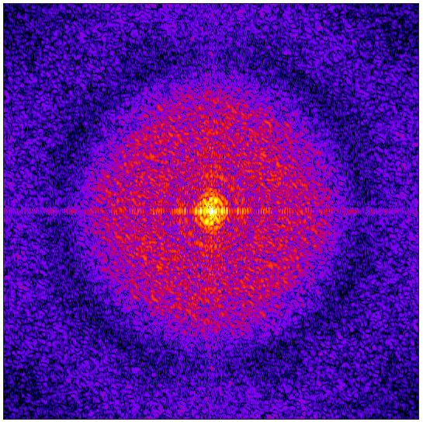
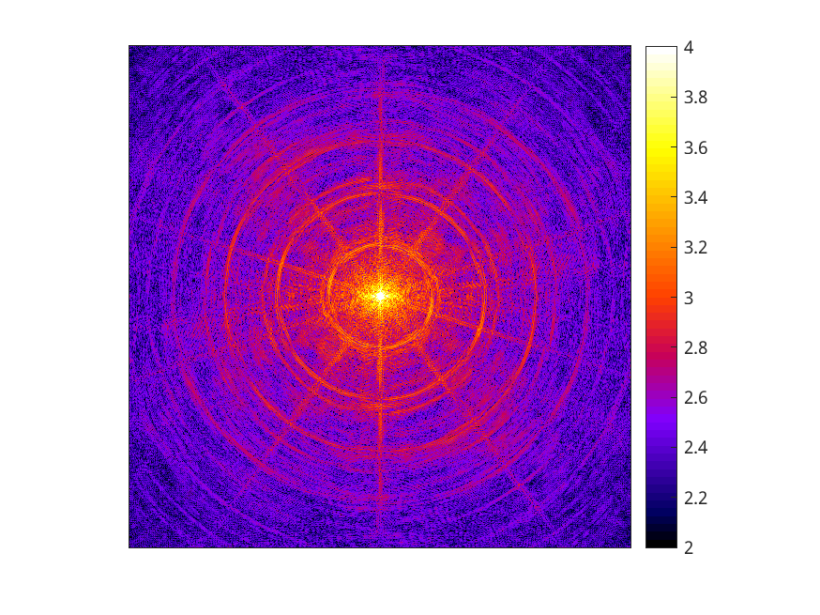
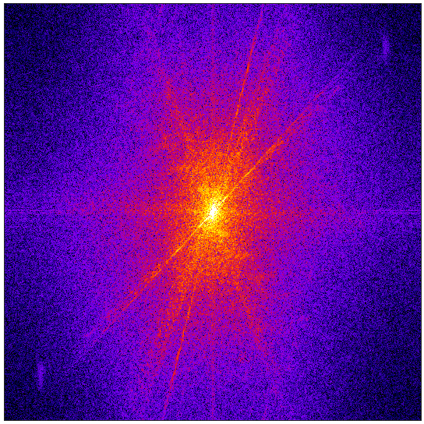
A
B
C
D
E
F
1
2
3
4
5
6
Notes:
Please find the corresponding pairs of images and FTs

